Slide 1
am

Slide 2
What do Ruth, Tabitha, Cornelius, and Stephen all have in common?

Slide 3
Ruth: "It has been fully reported to me, all that you have done for your mother-in-law since the death of your husband…” (Ruth 2:11).
Tabitha: “This woman was full of good works… and all the widows stood by him weeping, showing the tunics and garments [she] had made while she was with them” (Acts 9:36, 39).
Stephen: “Seek out from among yourselves seven men of good reputation… whom we may appoint over this business” (Acts 6:3).
Cornelius: “… A just man, one who fears God and has a good reputation among all the nation of the Jews…” (Acts 10:22).

Slide 4
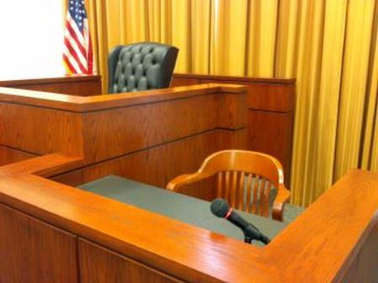
EYEWITNESSES
CHARACTER WITNESSES
HEARD TOO OFTEN:
“I don’t care what they think!”

Slide 5
MATTERS OF
REPUTATION

Slide 6
REPUTATIONS MEASURE OUR IMPACT ON OTHERS
The previous 4 examples had all affected others.
Our works should cause others to glorify God (Matt. 5:16)
Reputations are built over time (1 Tim. 3:6,10)
Our works serve as the evidence of our faith (4:15).
Our reputation is not confined to the church (3:7, 5:10).
REPUTATIONS ARE BASED ON OUR PAST EFFECT AND
THEY INFLUENCE OUR
FUTURE EFFECT
MATTERS OF
REPUTATION

Slide 7
REPUTATIONS MAY REVEAL ISSUES
Some reputations are unfair and slanderous (Rom 3:8).
Other reputations are fair and not good (Tts. 1:10-13).
The criticisms of others may be justified and it should cause us to examine ourselves.
If we know others based on their fruit (Matt. 7:20), then others know us by the same.
MATTERS OF
Other people’s opinions,
our reputations,
may reveal something wrong.
REPUTATION

Slide 8
HOW CAN WE CHANGE OUR REPUTATION?
We can change (Gal. 5:19-26).
We can work to soften their hearts (Rom. 12:20,21).
We can change and seek to rectify, like Zacchaeus.
We can say we are sorry and ask forgiveness, like prodigal.
We can deny ourselves for others’ sake (1 Cor. 9:19-23)
MATTERS OF
Reputations change through work, self-denial, humility, love,
and faithfulness.
REPUTATION

Slide 9
MATTERS OF
REPUTATION

Slide 10
am

